Slide 1


Day 03
contact@anubhavtrainings.com
ABAP RESTFUL APPLICATION PROGRAMMING

Slide 2

Agenda – Day 03
Common Challenges in ABAP Development
Evolution of ABAP Programming Model
What is RAP (Restful Application Programming)
Flow of Restful Application Programming
Types of Scenarios
Managed Scenario
Unmanaged Scenario
Explanation of Flight Data Model
Defining Unmanaged Scenario
Flow of Development (Unmanaged Scenario)
Defining CDS Views
Notes:
Local Types/Classes in ABAP with Global Classes
Implementing Class Pool Concept
Behavior Definition Introduction
Create Behavior Definition
Create Behavior implementation for Unmanaged Scenario
What is EML ?
Why we use EML
Syntax of EML
C-R-U-D Using EML
Implementation of EML
Introduction to Managed Scenario
Use Case for Managed Scenario
Describing Functionality of Scenario
Sequence Diagram
Implementing Create, Update and Delete
Make field read only
Making field Mandatory
Add validation to the code
Implement Actions - set_status_booked

Slide 3




Challenges in ABAP development
UI
Common needs
Create application logic
Insert, update, delete, validate, select data
Perform validations
Check customizing
Handle locks
Create A/c documents
Manage Documents
Application Code
I, U, D, S, V
Search Documents
Validate before save
Alex, ABAP Developer,
SAP FICO
UI
Challenges
Thinks differently
Adapt application code
High maintenance
No standardization
Different coding practices
Lack of standard
Create Sales Orders
Manage Sales Orders
Application Code
I, U, D, S, V
Search/Filter Sales Order
Compute Sales total
Stella, ABAP Developer,
SAP SD
Trainer: Anubhav Oberoy

Slide 4
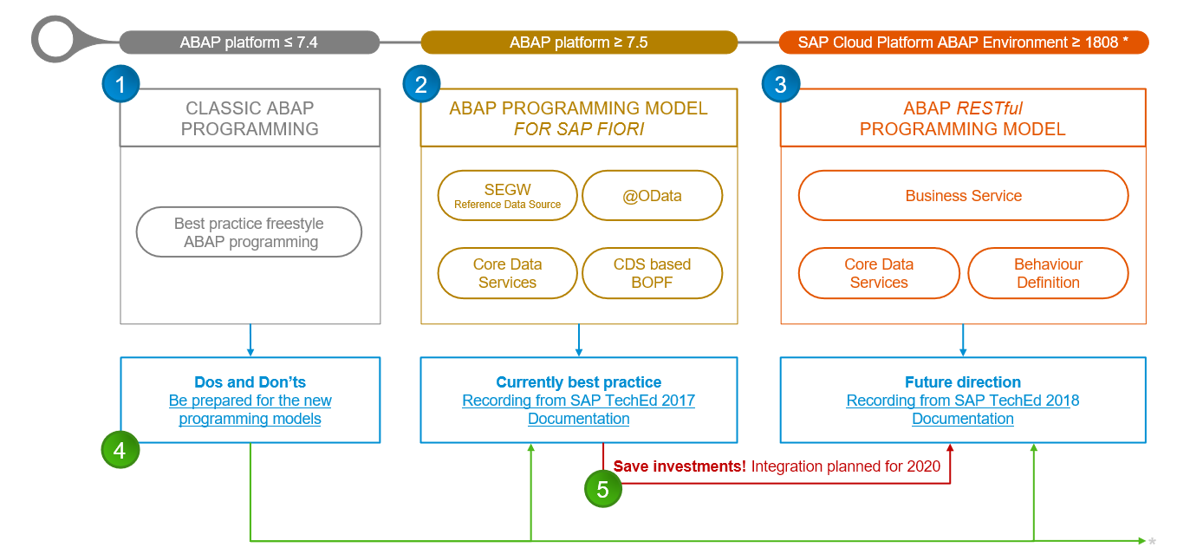
Evolution of ABAP Programming Model

Slide 5
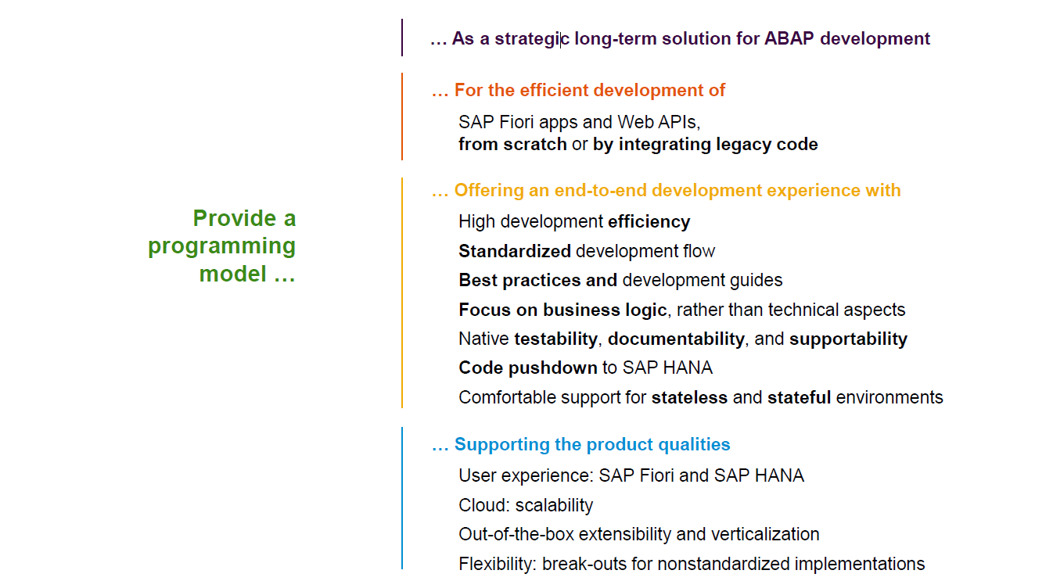
Restful ABAP Programming

Slide 6
Restful ABAP Programming
The ABAP RESTful programming model defines the architecture for efficient end-to-end development of intrinsically SAP HANA-optimized OData services (such as Fiori apps) in SAP Business Technology Platform ABAP Environment. It supports the development of all types of Fiori applications as well as A2X services. It is based on technologies and frameworks such as Core Data Services (CDS) for defining semantically rich data models and a service model infrastructure for creating OData services with bindings to an OData protocol and ABAP-based application services for custom logic and SAPUI5-based user interfaces .
The whole architecture is based on
CDS views – will helps you to create semantically rich data model.
Business Object here is a node inside a tree data structure which is achieved by using root keyword at CDS view level, this is needed only if we want to add transactional capability.
Finally create a service using service definition and service binding .
The binding will confirm the Purpose of service – API or Fiori.
UI layer with the Fiori app using elements.

Slide 7

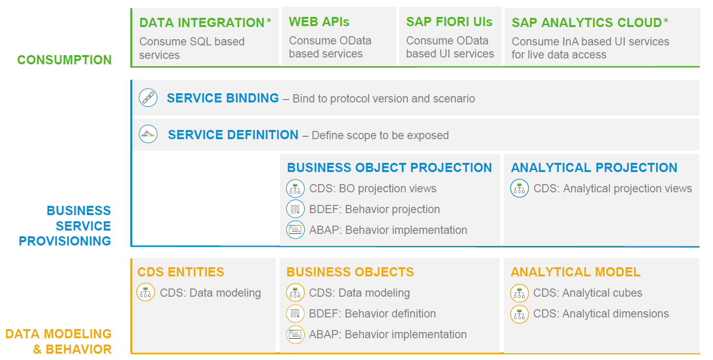
RAP – The Big picture

Slide 8
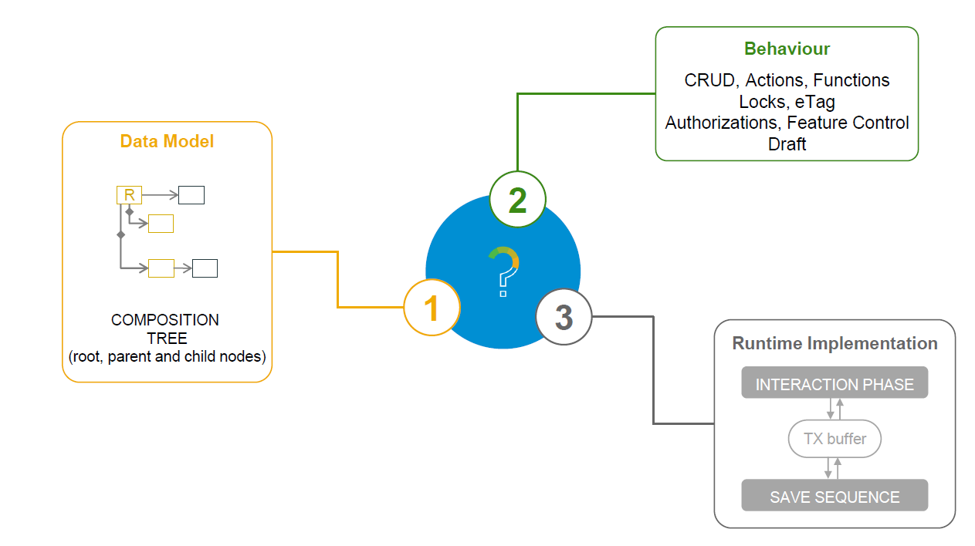
What is a Business Object

Slide 9
Types of Implementation (Scenario)
Brownfield Implementation
Is used when we want to create a transactional application which can insert, update, delete data from the system by writing your own logic
You already have Business logic with you and you want to use that business logic to perform transactional capability
You are own your own to manage your implementation.
02. Managed Scenario
Greenfield Implementation
Is used when we want to create a transactional application which can insert, update, delete data from the system by using the framework provided implementation
You do not have Business logic with you and you want system to create business logic for you automatically.
01. Un-Managed Scenario

Slide 10
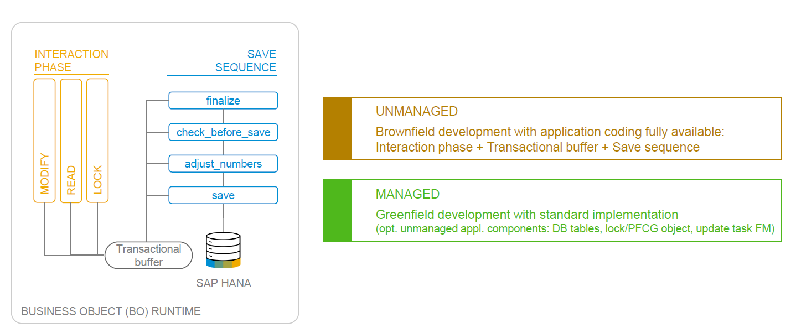
BO runtime implementation types

Slide 11
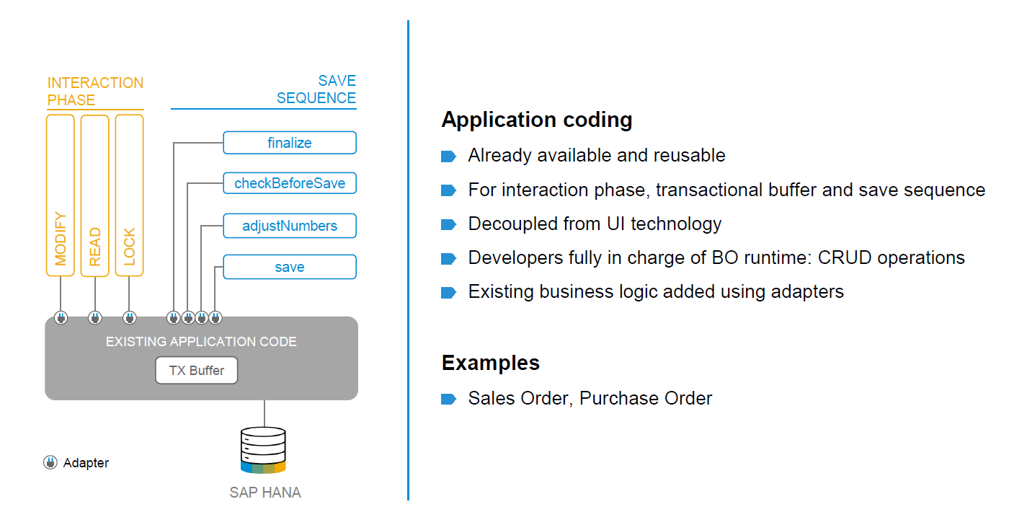
BO runtime implementation types

Slide 12

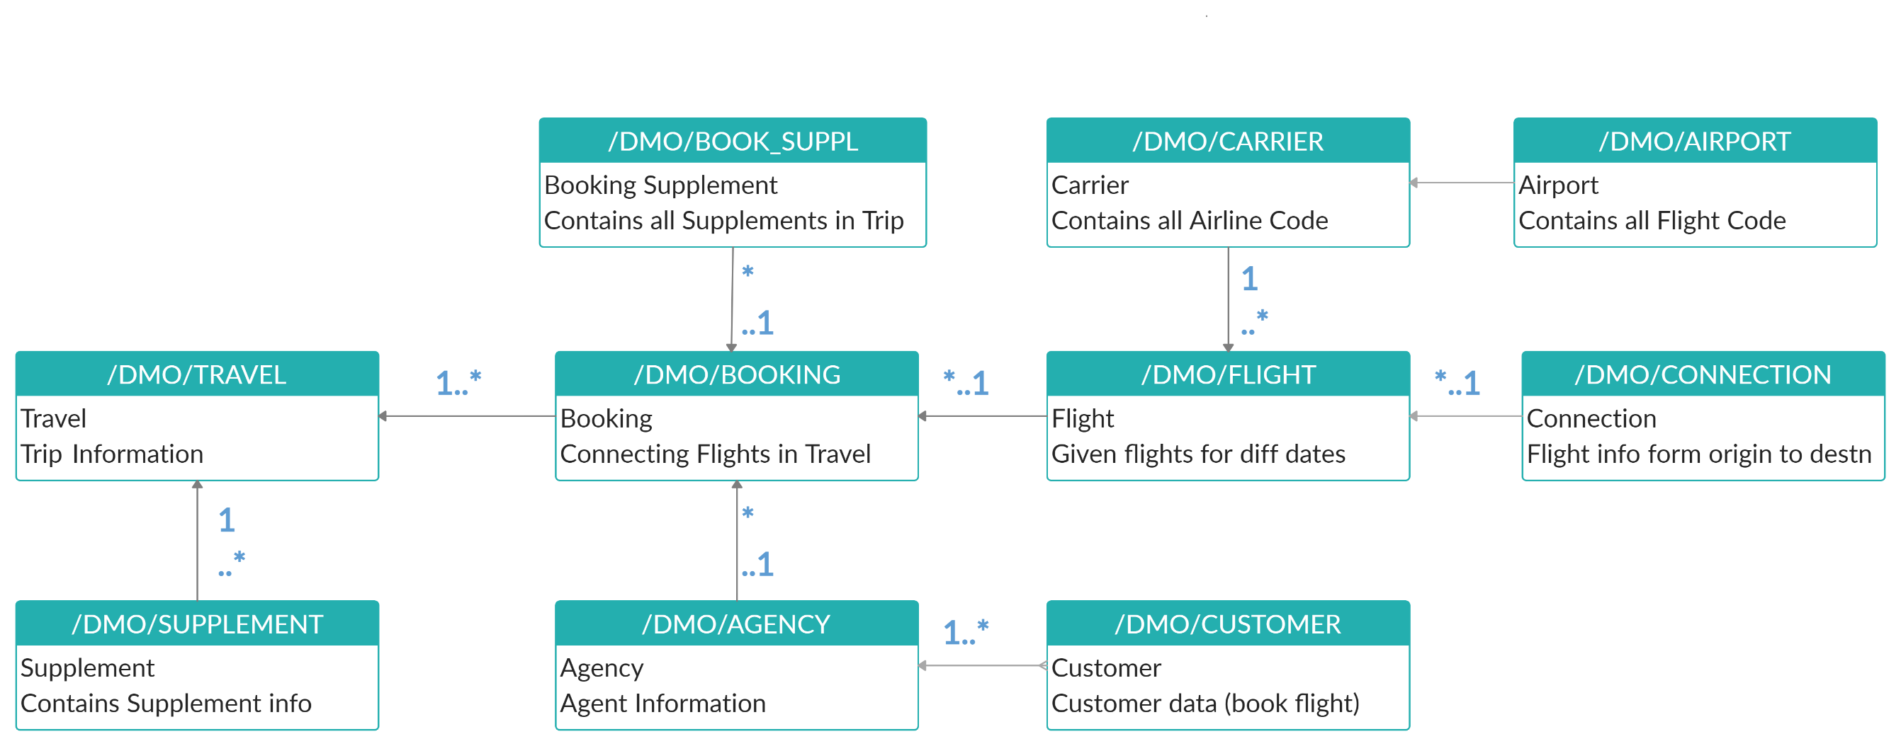
Explanation of Flight Data Model
If Data is not found in these Table’s please execute Data Generator Class “/dmo/cl_flight_data_generator”

Slide 13
Flow of Development (Unmanaged Scenario)
Fiori UI
Service Binding for UI
Service Definition
Travel – Using /demo/travel
Projection view- what we want to show to UI
1
N
I_Currency
1
N
N
Agency
Customers
I_Country

Slide 14
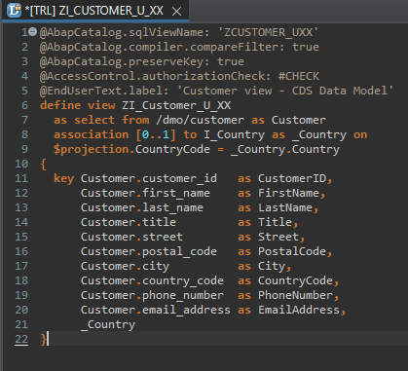
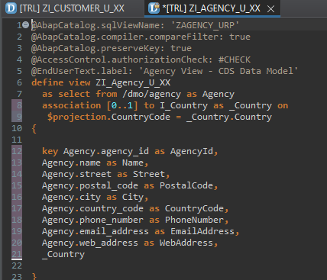
Defining Data Models
Defining Data Models
Create Customer CDS View “ZI_Customer_U_XX”
Create Agency CDS View “ZI_Agency_U_XX”

Slide 15
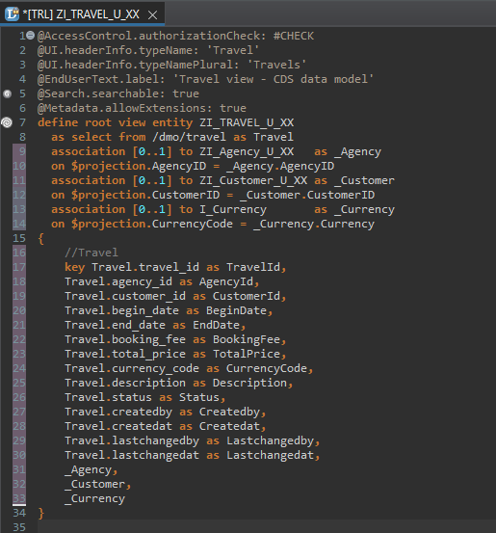
Root CDS Entity
Root CDS Entity
On top of Customer and Agency CDS View we Create Root CDS View Entity called “ZI_TRAVEL_U_XX”.
With Annotations like Metadata ,Search ,
Semantic Annotation etc.
Association to Agency ,Customer , Currency.

Slide 16
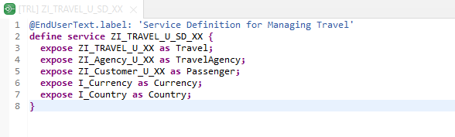
Create OData Service ( Business Service )
Create OData Service ( Business Service )
A business service definition (short form: service definition) describes which CDS entities of a data model are to be exposed so that a specific business service, for example, Sales Order handling, can be enabled. It is an ABAP Repository object that describes the consumer-specific but protocol-agnostic perspective on a data model. “ZI_TRAVEL_U_SD_XX”
CDS Entity
Service Definition
Service Binding

Slide 17
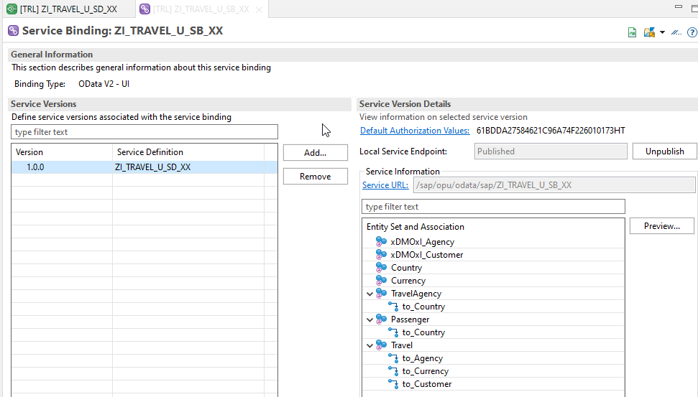
Service Binding ( Business Service )
Service Binding ( Business Service )
The business service binding (short form: service binding) is an ABAP Repository object used to bind a service definition to a client-server communication protocol such as OData. Like any other repository object, the service binding uses the proven infrastructure of the ABAP Workbench, including the transport functionality

Slide 18

Introduction to SAP Fiori Elements
SAP Fiori elements provides standard floorplans and uses metadata to streamline and accelerate developing SAPUI5 applications.
SAP Fiori elements
▪ Delivers enterprise-ready SAPUI5 apps based on
stable, optimized, out-of-the-box UI code
▪ Boosts developer efficiency by scaling development
and maintenance in a cost-efficient way
▪ Provides a centrally managed, consistent UX
complying with the latest SAP Fiori design
▪ Ensures upgrade stability and forward compatibility
▪ Allows extensibility of standard floorplans with custom
controls and logic
www.anubhavtrainings.com

Slide 19
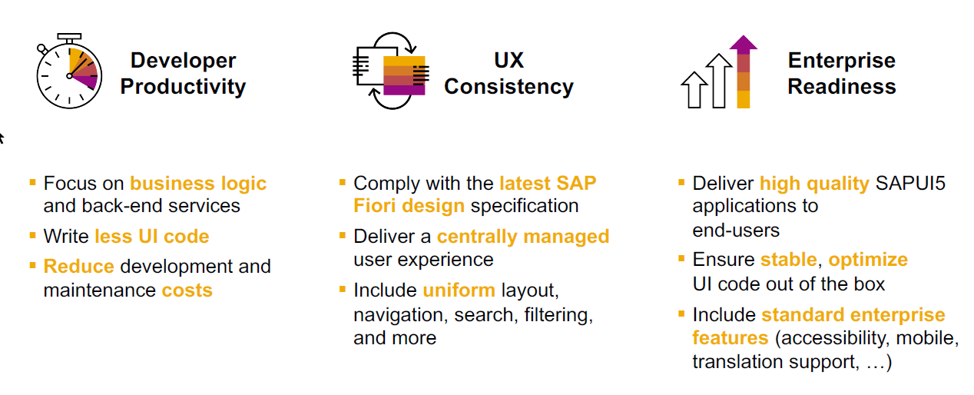
SAP Fiori elements boosts SAP Fiori development efficiency
www.anubhavtrainings.com

Slide 20

SAP Fiori elements prioritizes efficiency over flexibility
www.anubhavtrainings.com

Slide 21


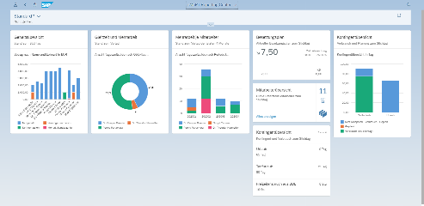





Developer Persona – Fiori Elements
Anubhav
Happy User
Rob
S/4HANA Technical consultant
ABAP Developer
Roxana
UX Designer | Fiori Developer
ABAP Dev. Tools
On
Eclipse
VS Code
BAS
OData Service
Fiori Elements Project
Annotations.xml
CDS Views
MDE
@
www.anubhavtrainings.com

Slide 22
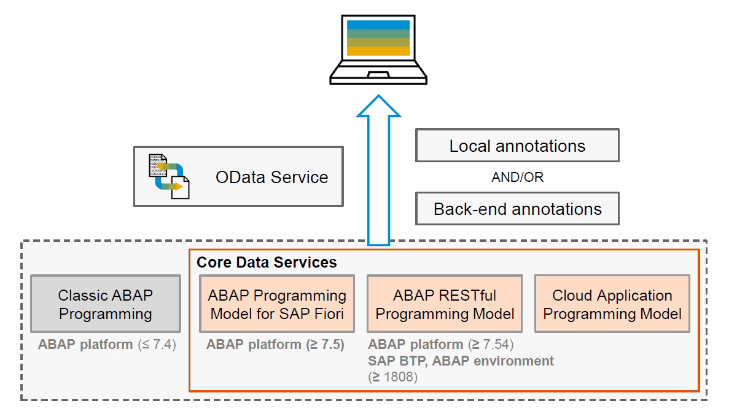
Big Picture – Architecture
www.anubhavtrainings.com

Slide 23
Metadata extension
When we develop CDS views, we can put many annotations inside CDS. But when we looking forward to develop a UI application, we want @UI annotations. By putting these UI annotations directly inside CDS, we are talking risk.

Slide 24
Fiori Elements - List Report Application
The list report offers powerful features for finding and acting on relevant data sets. It is often used as an entry point for navigating to the item details, which are usually shown on an object page.
List Report
Object Page
www.anubhavtrainings.com

Slide 25
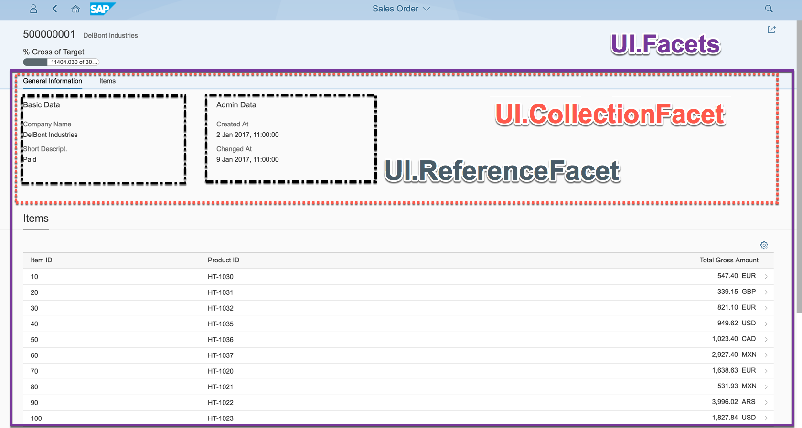
Object Page
www.anubhavtrainings.com

Slide 26
Developing Read only List Report
UI Annotations
@UI.selectionField – Bring a filter field on smart filter bar
@UI.lineItem – enable us to put a column inside the smart table, position, label
@UI.identification – used create fields in Object page
@Semantics.amount.currencyCode – mark the unit of amount field
@UI.headerInfo.typeName – Label for displaying single record
@UI.headerInfo.typeNamePlural – Table Label
@UI.facet: [{purpose : #STANDARD – This will create a section inside the object page
type: #IDENTIFICTION_REFERENCE – What type of data you want to display}]
Metadata Extension
MDE file for Travel
Documentation
Documentation Link for ABAP RAP

Slide 27
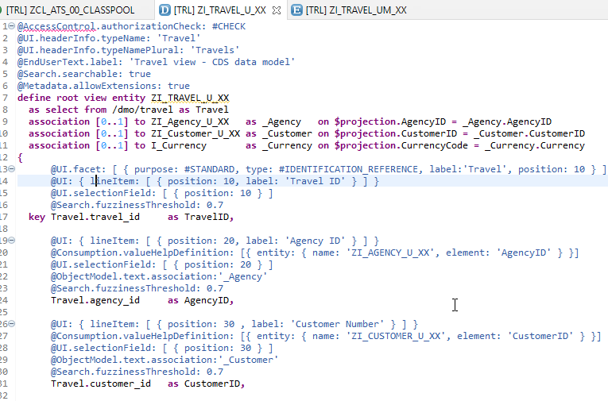
CDS Views with Annotations
Exercise
ZI_TRAVEL_U_XX ( Travel )

Slide 28
Local Types/Classes in ABAP with Global Classes
Local Types for Global Classes - Within class pools, as in virtually any other ABAP program, data types, local interfaces, and local classes can be defined to ensure a better structure of the implementation of the global class.
More number of classes will cause confusion and over-modularization increase the complexity of our design
More number of global classes, will increase the chance of our code being exposed to reports/classes which we may want to use only a private
Allow a modularized way of designing app but still keeping our code in a single contain, a good balance between number of classes v.s modularization.
At times we need so many classes for different purpose with very limited no of methods. 2 meh. + 20 classes, Create a class pool would be a good options.

Slide 29
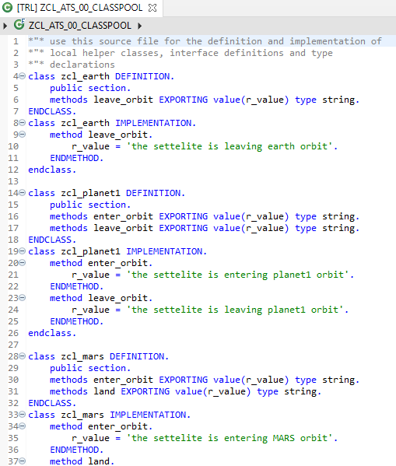
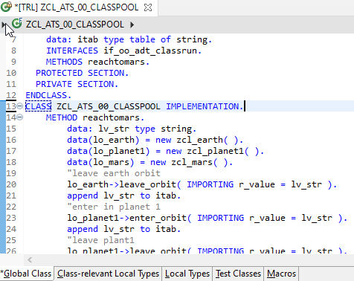
Implementing Class Pool Concept
Global Class
Exercise
Class Pool Code
Local Types/Class

Slide 30
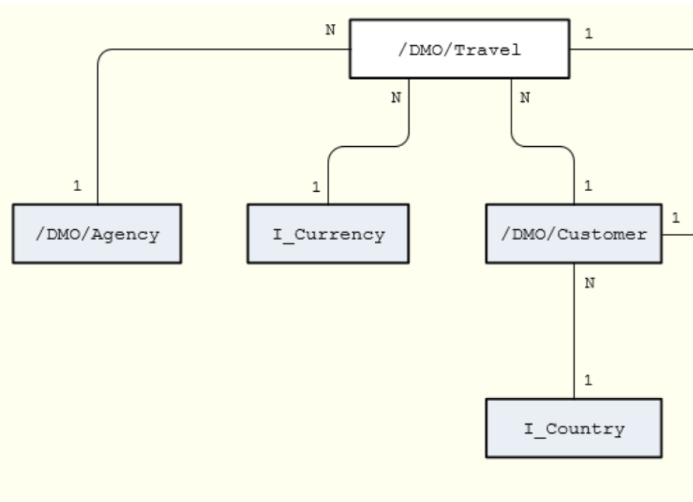
Un-managed Implementation
The scenario described below focuses on an unmanaged implementation type of a business object provider in the context of the ABAP RESTful programming model.
For the unmanaged implementation type, the application developer must implement essential components of the REST contract itself. In this case, all required operations (create, update, delete, or any application-specific actions) must be specified in the corresponding behavior definition before they are manually implemented in ABAP.
The figure below shows the relationships between the travel, agency and customer entities where the travel entity represents the root of the data model. Additional entities for currencies (I_Currency) and countries (I_Country) are generally available in your system and are included in our data model using associations.

Slide 31
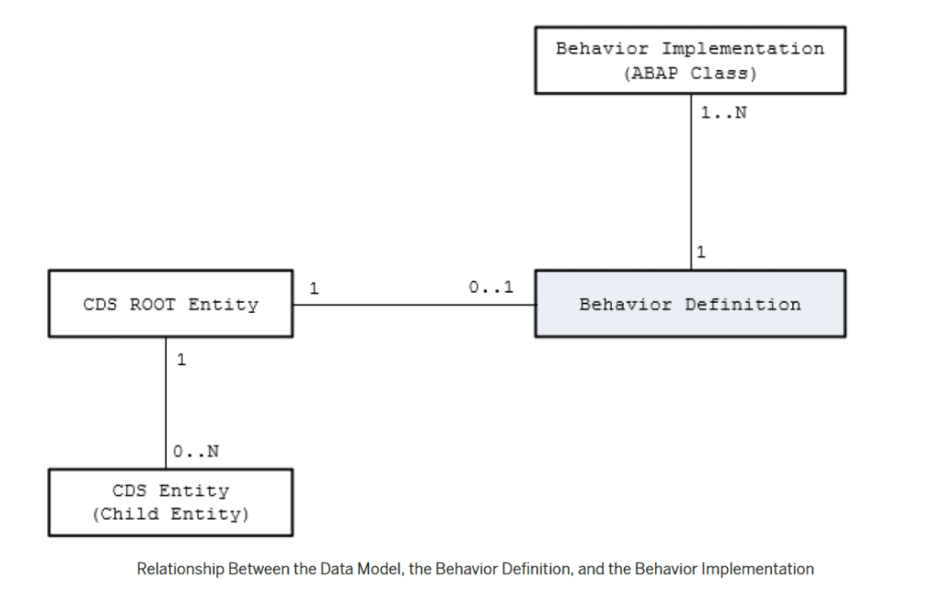
Behavior Definition
A business object behavior definition (behavior definition for short) is an ABAP Repository object that describes the behavior of a business object in the context of the ABAP RESTful programming model.
A behavior definition is defined using the Behavior Definition Language (BDL) and comprises capabilities and modelling aspects of the business object node or nodes, for example the supported operations (such as create, update, and delete actions) or the definition of lock dependencies between the parent and child nodes.
A behavior definition always refers to a CDS data model. This reference results from the name equality with the root entity. This means that a CDS data model must always exist before the behavior definition is created.
A behavior definition relies directly on the CDS root entity.
One behavior definition refers exactly to one root entity and one CDS root entity has a maximum of one behavior definition (a 0..1 relationship), which also handles all associated (child) entities.
The implementation of a behavior definition can be done in a single ABAP class (behavior pool) or can be split between an arbitrary set of ABAP classes (behavior pools). You can assign any number of behavior pools to a behavior definition (a 1: n relationship).

Slide 32
Behavior Pool
The transactional behavior of a business object in the context of the current programming model is implemented in a global ABAP class or classes. These special classes are dedicated only to implementing the business object’s behavior and are called behavior pools.
the implementation of a behavior definition can be done in one class or split across an arbitrary set of ABAP classes.
You can assign any number of behavior classes to a behavior definition (a 1: n relationship). Within a single global class, you can define multiple local classes that handle the business object’s behavior.
The global class is just a container and is basically empty while the actual behavior logic is implemented in local classes.
Local class 1 for Entities
Behavior Definition
Class Pool
Local class 2 for Entities
Local class 3 for Entities

Slide 33
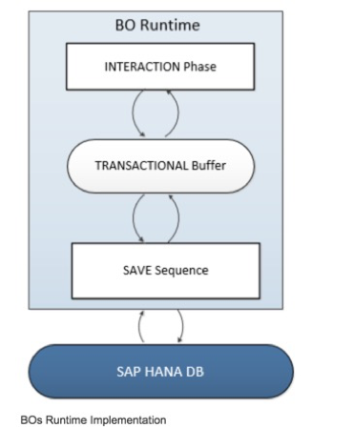
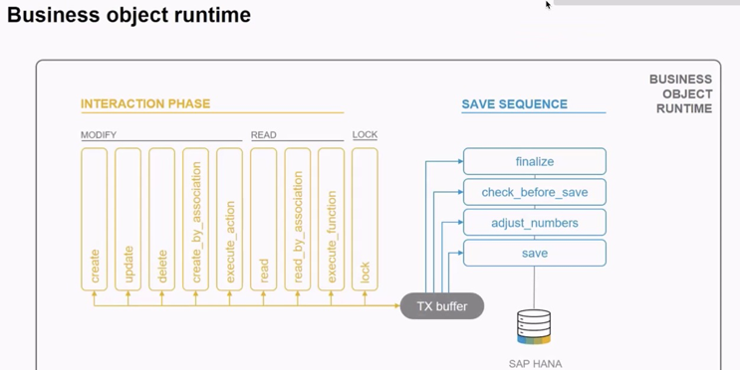
Business Object’s Runtime Implementation
The business object runtime mainly consists of two parts: The first part is the interaction phase where a consumer calls the business object operations to change data and read instances with or without the transactional changes. The business object runtime keeps the changes in its internal transactional buffer which represents the state of the instance data. This transactional buffer is always required for a business object. After all changes were performed, the data can be persisted. This is realized with the save sequence.

Slide 34
What is %CID
%CID stands for the content ID and is used in an OData request to bind the result of an operation to a name so that it can be referenced in another operation later in the transactional processing.
In some use cases, it may happen that a consumer works with data that is not yet persisted and might not have a primary key yet. The primary key can be created in the <method> FOR MODIFY call or later in the save sequence (late numbering). In such cases, a temporary primary key, the content ID (%CID) for an instance, is used as long as no primary key was created by BO runtime. The content ID is consequently also used then as a foreign key.

Slide 35
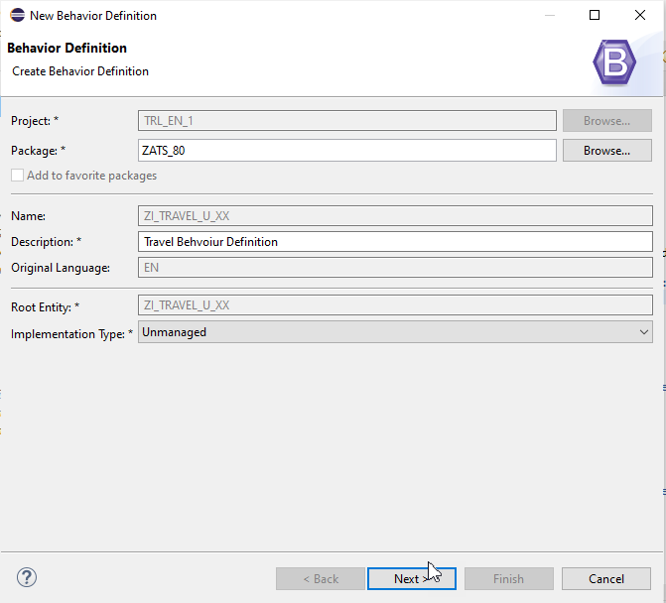
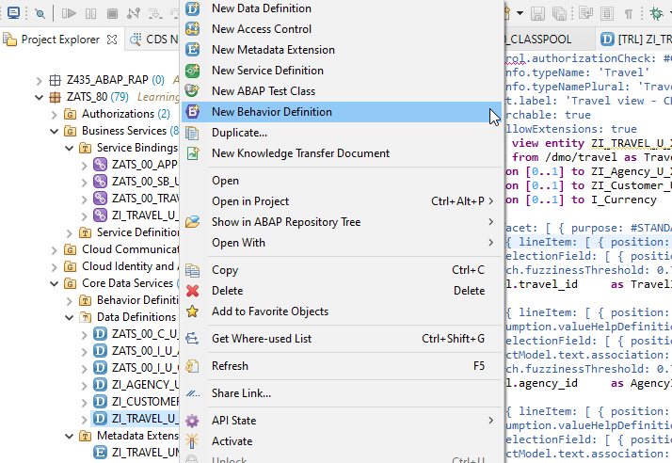
Create of Behavior Definition

Slide 36
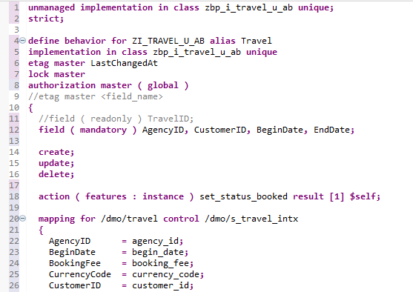
Implementing Behavior Definition
Exercise
Behavior Definition Code

Slide 37
Fiori App
OData
RAP
B-IMP
Legacy Code
post
Agency customer id
Start date
End date
Create
Create IMPORT
Entities (%cid)
Write to TB
messages
save
Save to DB
cleanup

Slide 38
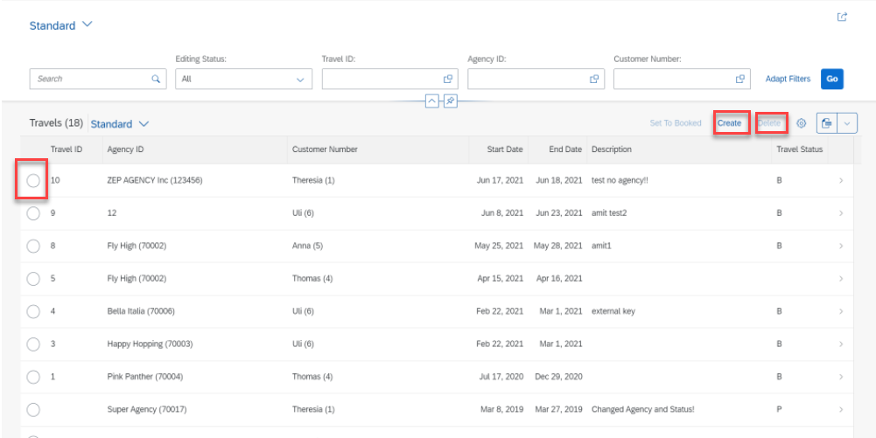
Implementing Create, Update and Delete
For the Functionality of Create ,Update & Delete we Implement the Code in Behavior Definition Class.
Step 1: Click Create Button.

Slide 39
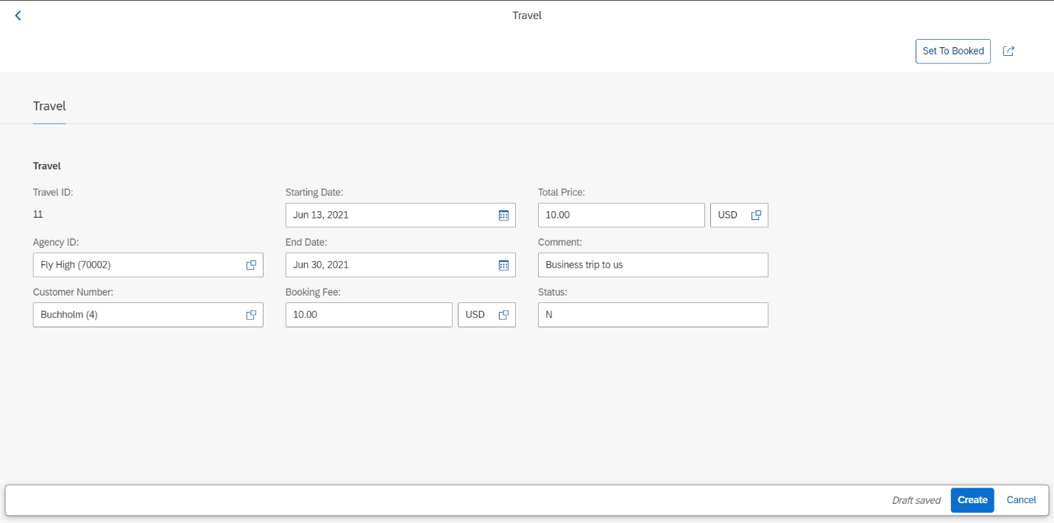
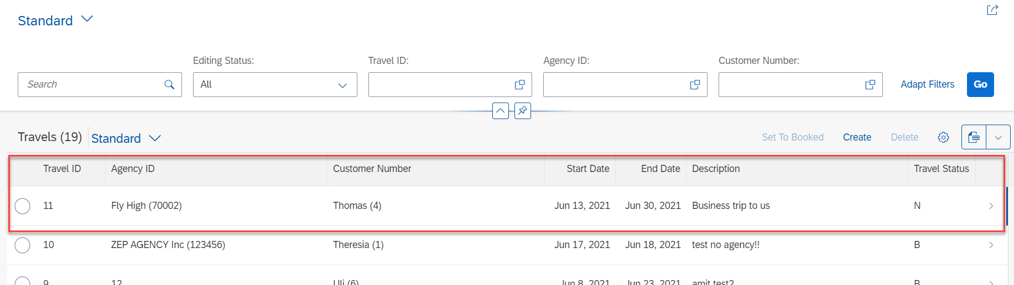
Implementing Create
Step 2: Fill all Correct Entries and Click on Create Button.

Slide 40
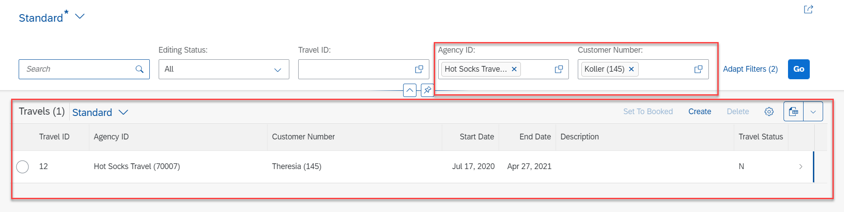
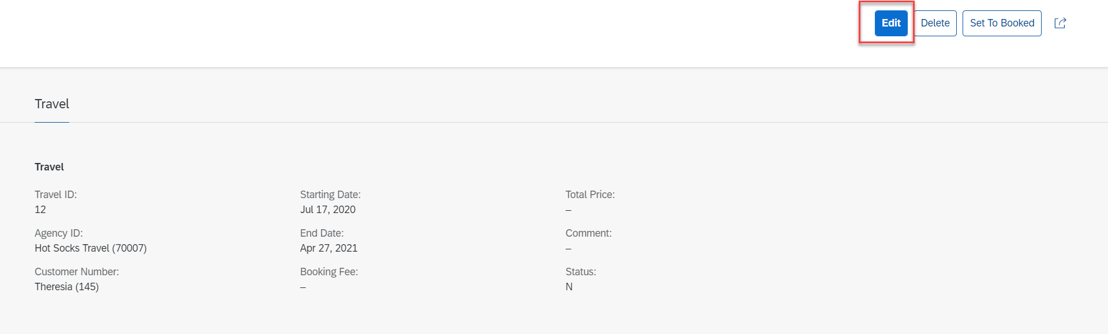
Implementing Update
Step 3: Select a Radio Button and Click Edit Option for Update.

Slide 41
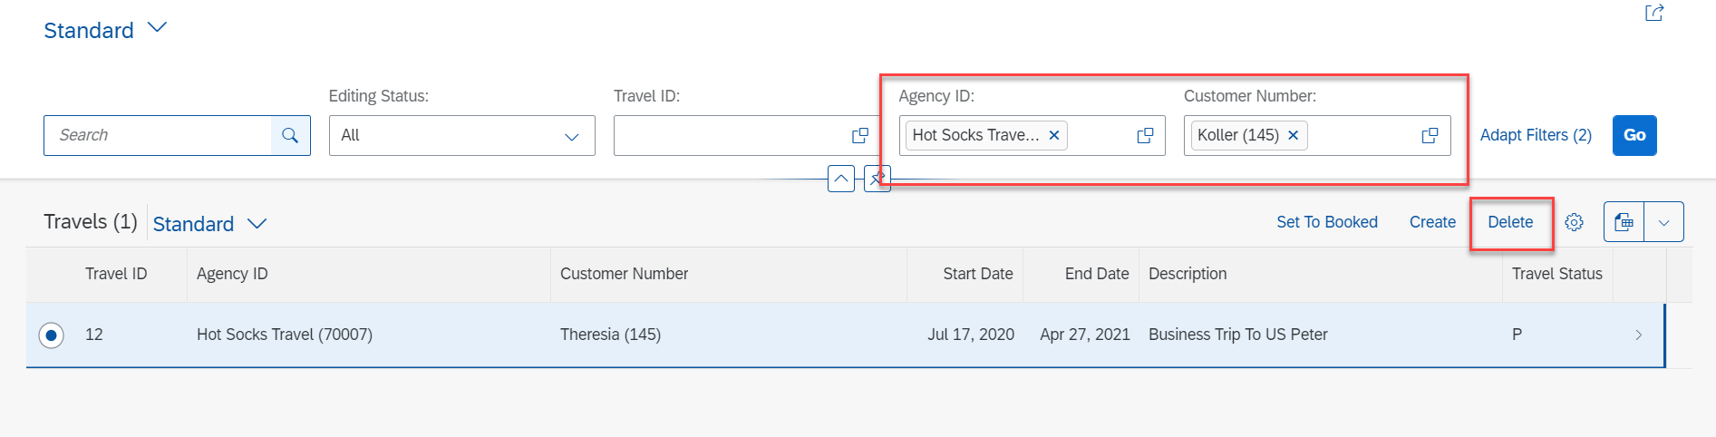
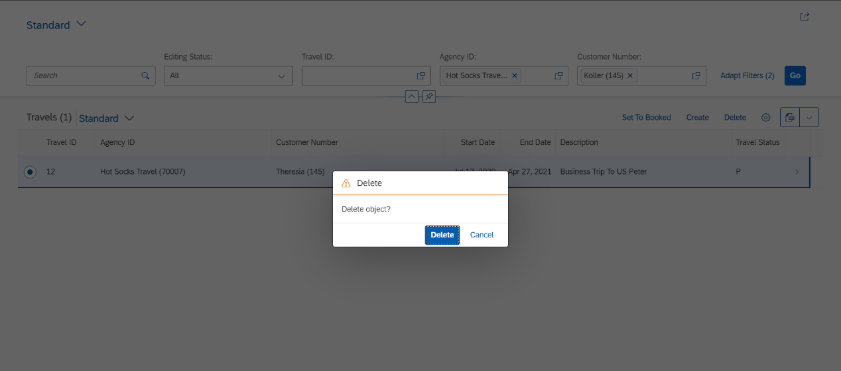
Implementing Delete
Step 4: Select a Radio Button and Click on Delete Button.

Slide 42
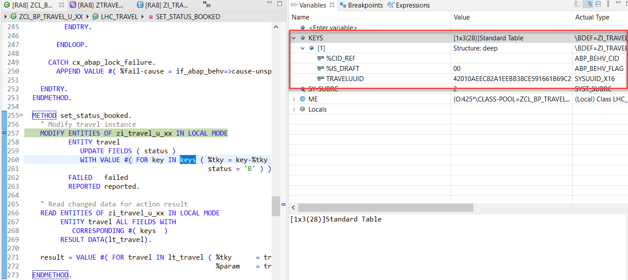
Action Implementation
“Actions” are addition operations in addition to CRUD operations. Are the operations which are non-standard for a business object
Below steps describes the implementation of an action related to the travel instances. Using this action, the end user should be able to change the status of travel processing.
Adding a Type Definition for Import and Export Parameters Required for the Action SET_STATUS_BOOKED
Implementing the Action Handling.

Slide 43
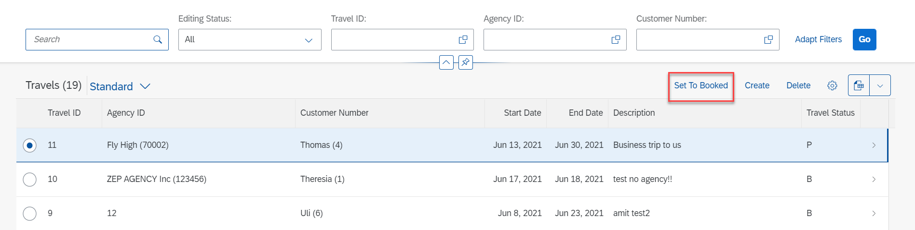
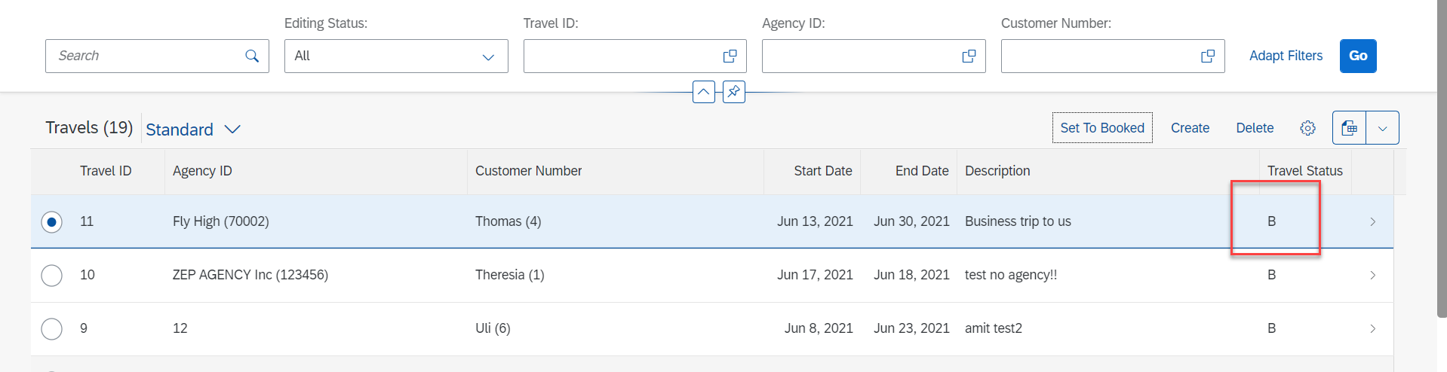
Action Implementation
Select Radio Button and Click on Set To Booked & Travel Status Change to Book (B)

Slide 44
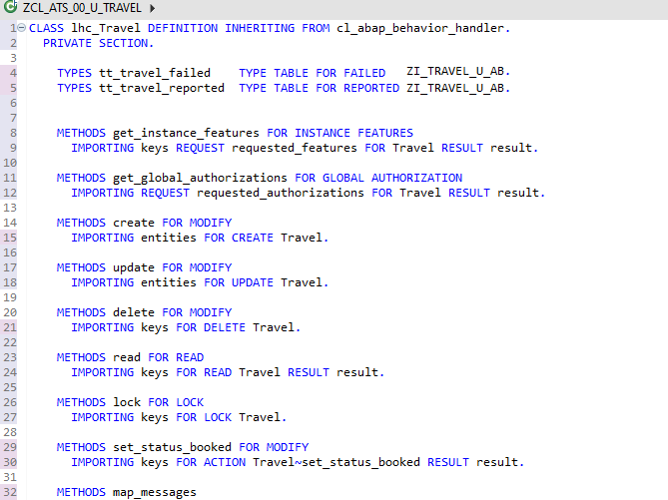
Behavior Pool Logic
Exercise
Behavior Pool Logic

Slide 45
What is EML ?
The Entity Manipulation Language (EML) is a part of the ABAP language that enables access to RAP business objects. Because the consumption of business objects via the OData protocol requires a Fiori UI or a web API, EML enables a type-safe access to business objects directly by using ABAP.
A Business Object in RESTful ABAP is consists of multiple Entities. This is a entity composition tree with one entity acting as a root. EML is part of the ABAP language and used in context of RESTful ABAP to control the BO behavior (create, read, update, delete).
We can use the EML in ABAP to test our BO. We can call the BO using EMP from ABAP program in 2 ways
01
Standard (Statically)
Generically (Dynamic) framework.
02

Slide 46
Syntax of EML
The EML provides us 3 important access statements for Data Manipulation using BO( Business Object ).
01
Perform the CUD ( Create ,Update ,Delete on BO
MODIFY ENTITIES OF RootEntityName
ENTITY EntityAliasName
[ CREATE FROM it_instance_c ]
[ UPDATE FROM it_instance_u ]
[ DELETE FROM it_instance_d ]
[ CREATE BY \AssociationName FROM it_instance_cba ]
[ RESULT et_result_tab ] [ FAILED failed ] [ REPORTED response ] [ MAPPED mapped ]
02
Commit Entities
Will actually persist the changes in the DB from transaction buffer. Any modify operation that are executed within behavior pool or by ABAP program are not causing any DB change because they are applied on transaction Buffer and this buffer content will disappear when ABAP session ends. So if we want the changes to be passed to SAVE SEQUENCE and persisted, we will use the COMMIT ENTITIES statement.
finalize ( )
check_before_save( )
Adjust_numbers( )
Save( )

Slide 47
Syntax of EML
03
Read the Data
All operations that do not need to change the data of an entity are carried out by READ Data.
There 2 types of Read
Read Entity by Key
Read Access to child (association) by parent key
Read Statement always returns the RESULT and you must specify target variable. We can also read the associated entity data using BY \asso_name FROM it_table syntax.
The result of associated data with come in another internal table LINK tab_name, it will always contain the key value pair.
READ ENTITIES OF RootEntityName
ENTITY EntityAlias FROM it_read_condition
RESULT et_result
BY \asso_name FROM it_read_rba
RESULT et_res_rba
LINK et_link_keys
ENTITY EntityAlias FROM it_ins_2…. [ FAILED failed ] [REPORTED reported]

Slide 48

Rule for EML
In addition to the data we also have a compiler generated field in input and output results called %control, this field is responsible to inform the RESTful framework that, which are all the fields we would like to send to DB while creation or update while updating. Also while read we can specify the same to avoid reading everything.
We can also see the complete BO structure in BO Explorer using keyboard shortcut :-
Alt+Shift+W

Slide 49
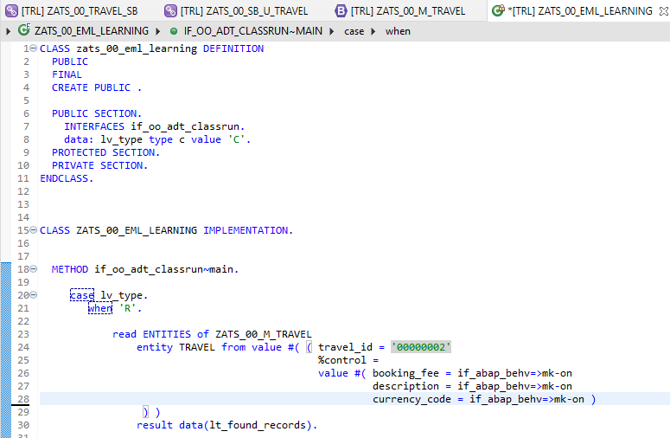
Implementing EML
Exercise
ZATS_00_EML_Learning

Slide 50
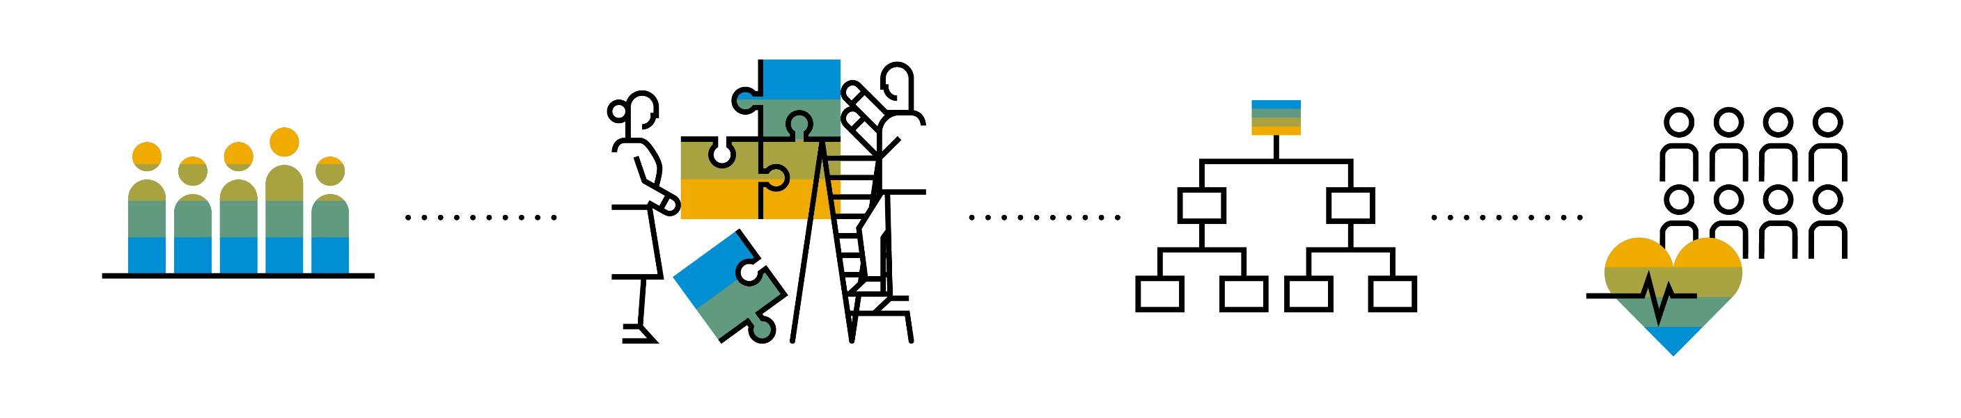
Introduction to Managed Scenario
Let us consider we have been given a green field and asked us to develop a villa from scratch with our own customization. So, what steps will be involved in it? We need to design the floor-plan of the villa, the sections we want to include in the house like pool area, a garden, a jogging track etc. And we will proceed with selecting materials, selecting vendors, enforcing conciliation and orders and many more steps. Similarly, the RAP’s managed scenario provides the greenfield development for our business object.
In the managed scenario, the implementations of behavioral elements like Create/Update/Delete are managed by the RAP framework itself. However, to implement complex logic like validations, determination or some sort of actions (Submit, Approval, Reject etc.) on the business entity, you need to add the ABAP logic for it in implementing classes.

Slide 51
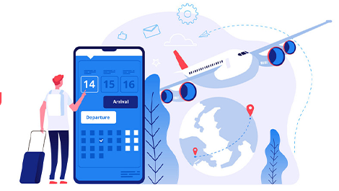


Use Case for Managed Scenario
I am working as a ABAP on Cloud developer for one of the travel planner agency, which has just taken the BTP subscription. They want me to create 2 fiori apps for the travel industry
Processor Application
Approver Application
MakeMyTrip.com
Source → Destination
Start → End Date
How many
Travel Itinerary
Travel Request which has multiple Bookings
Create a travel request and add bookings with all the properties changeable
Updates booking fees and description and provide approvals
Processor
Approver

Slide 52

Steps for Build Use Case
Fiori App for Processor
Fiori App for Approver
Service Def and Binding
Service Def and Binding
CDS Data Model
CDS Projection for Processor @UI
CDS Data Model
CDS Data Model
CDS Projection for Approve @UI
Introduction
1..1
Behavior Def
Projection (processor)
Behavior definition
Behavior definition
Behavior Def
Projection (approver)
Behavior definition
Behavior Implement (pool)

Slide 53
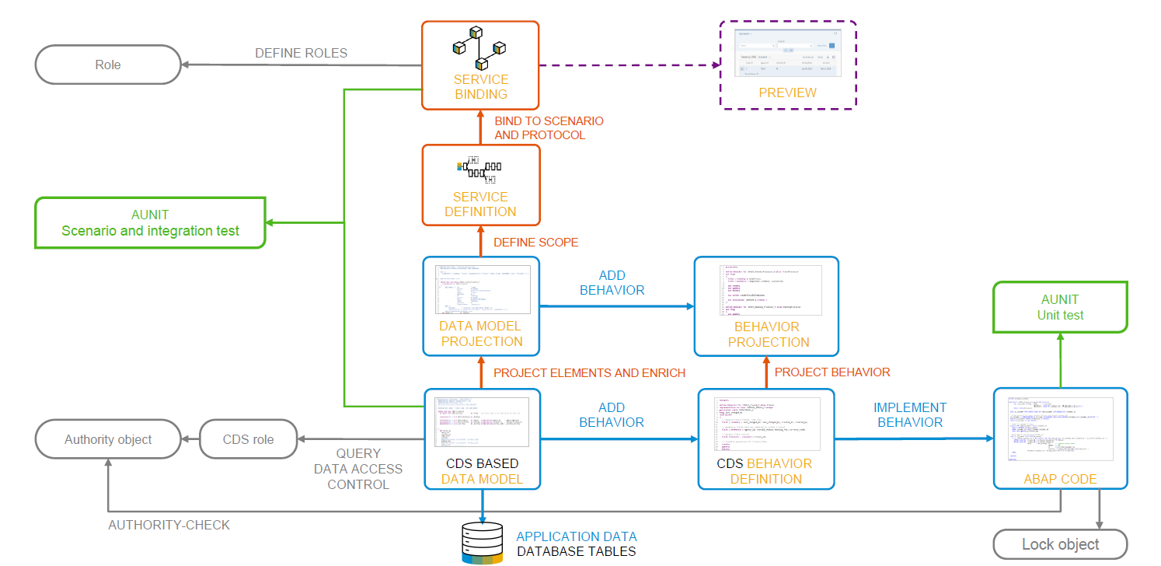
Development flow

Slide 54
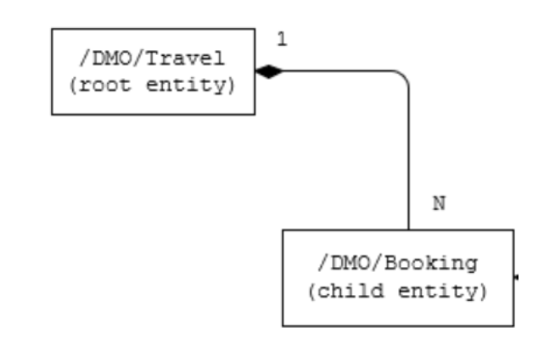
Our new Business Object
From a structural point of view, a business object consists of a tree of entities that are linked by compositions. Every entity in this composition tree is an element that is modeled with a CDS entity. For our demo travel booking scenario, we will implement a 2-level hierarchy composition tree.
As depicted in the figure below, the 2-tier entity hierarchy for managing transactional data in our scenario consists of the following editable entities, with a 1: N cardinality on each level:
Travel
Booking
i.e. each travel instance has 0..N bookings The figure below shows the composition relationship between the travel and the (flight) booking entities, where the travel entity represents the root of the data model.

Slide 55

End of Day 03
Trainer: Anubhav Oberoy

Slide 56
Trainer: Anubhav Oberoy

Slide 57
THANK YOU
If you cannot do
great things, do small things in a great way.
Anubhav Oberoy
https://www.anubhavtrainings.com

Slide 58


We’re committed to empower you to be
Most Desirable Resource
through powerful training solutions.
We build the workforce of the future.
250+
Corporate Clients
30,000+
Learners Trained
25000+
Learners Placed
FREE WEBINARS
Sign up for free webinars with industry experts every fortnight!
Enroll Now!
Contact us today!
https://anubhavtrainings.com/

Slide 59




More from AnubhavTrainings.com

